Slide 1
INTELLIGENT ALERT SYSTEM
FOR FOREST TRIBAL PEOPLE
BY
RAHUL TEJA
18311A12J8
IT-D

Slide 2
ABSTRACT:
All the tribal population of India were traditionally closely associated with forests, and there are some who even today spend the greater part of their lives in the proximity of trees and villages or clans near to forest. If any dangerous predators when entered into a village or clan may lead to loss of resources or in extreme cases leads to loss of life.
The proposed Intelligent alert system for forest tribal people model is based on neural networks (CNN) incorporated with an alerting system. This system will monitor the entire villages of surrounding forests at regular intervals through a camera. Once any dangerous animal is detected then it will send information to the people in the village and it will produce an appropriate sound or alarm in the village to alert the people.

Slide 3
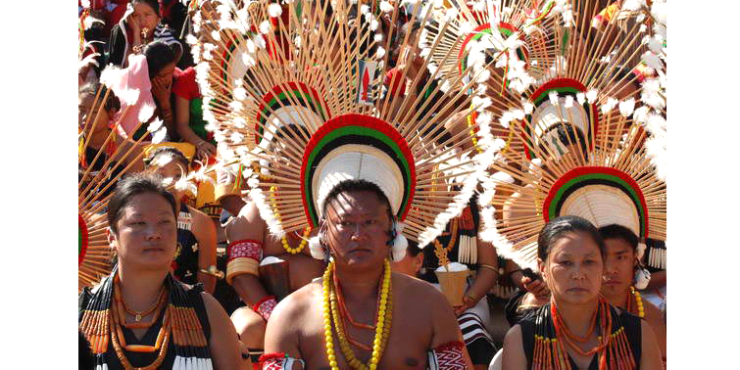
TRIBAL PEOPLE

Slide 4
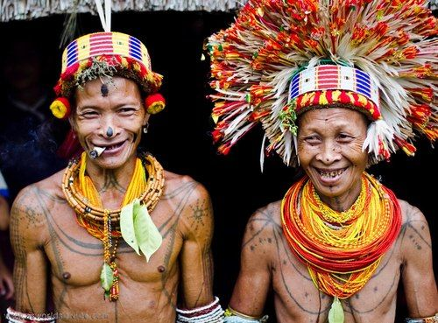

Slide 5
INTRODUCTION:
Human–wildlife conflict is a serious challenge undermining the protection of tribal regions. Developing effective human–wildlife conflict mitigation strategies requires an understanding of the conflict patterns, species involved and attitudes of local people living along protected area boundaries.The major types of human−wildlife conflict are crop raiding, livestock predation, increased risk of livestock diseases and direct threats to human life. Active measures are to be implemented to mitigate these problems and safeguard the future of the wildlife. Hence we came up with this “Intelligent Alert System”.

Slide 6
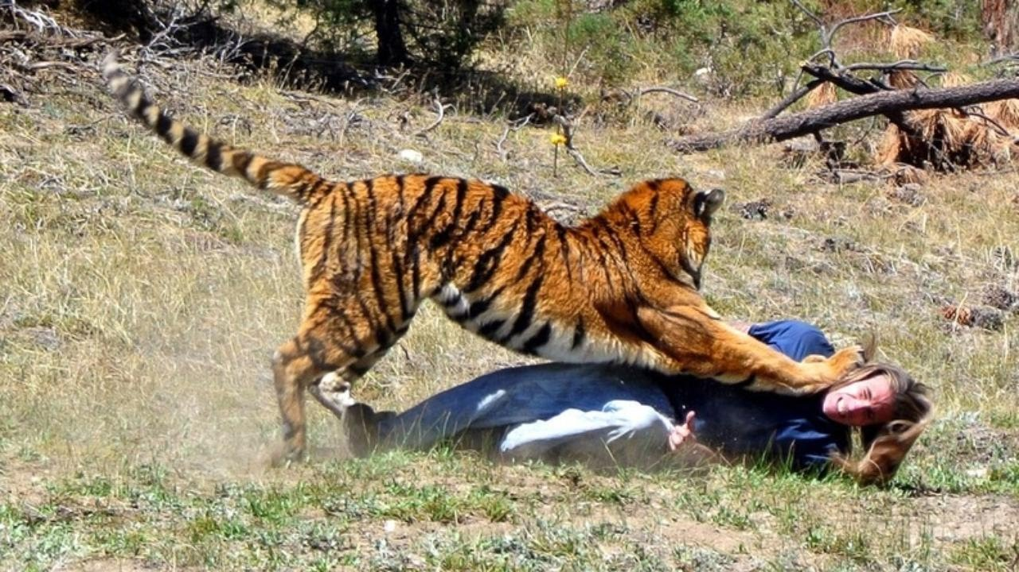
HUMAN-WILDLIFE CONFLICT:

Slide 7
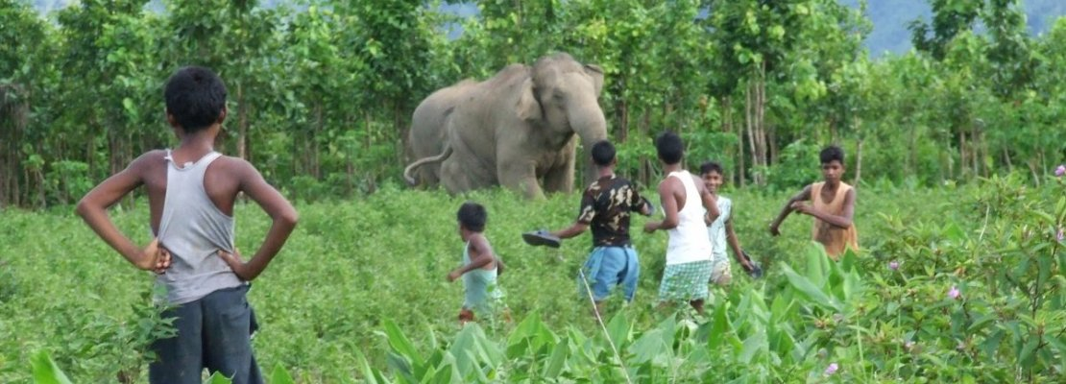

Slide 9
HARDWARE AND SOFTWARE REQUIREMENT:
HARDWARE:
RAM : 4GB RAM or higher
Hard disk : 40GB or higher
Cameras
SOFTWARE:
Operating System : Windows 7 , Windows 8 or higher versions
Language : Python 3 (Anaconda – Jupyter notebook)

Slide 10
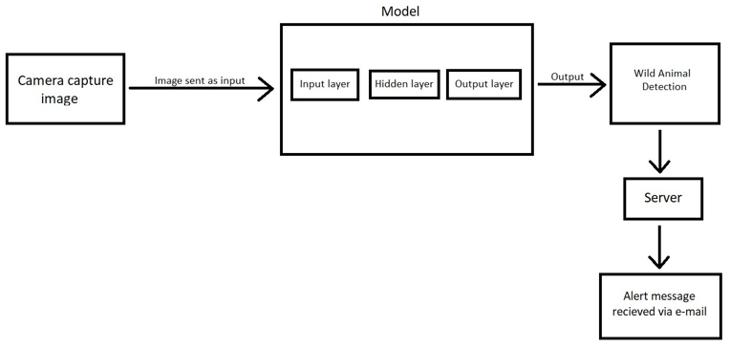
DESIGN:
DIAGRAM:

Slide 11
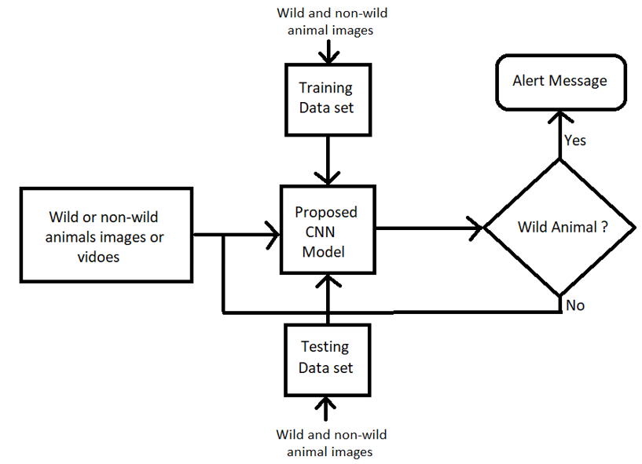
FLOWCHART:

Slide 12
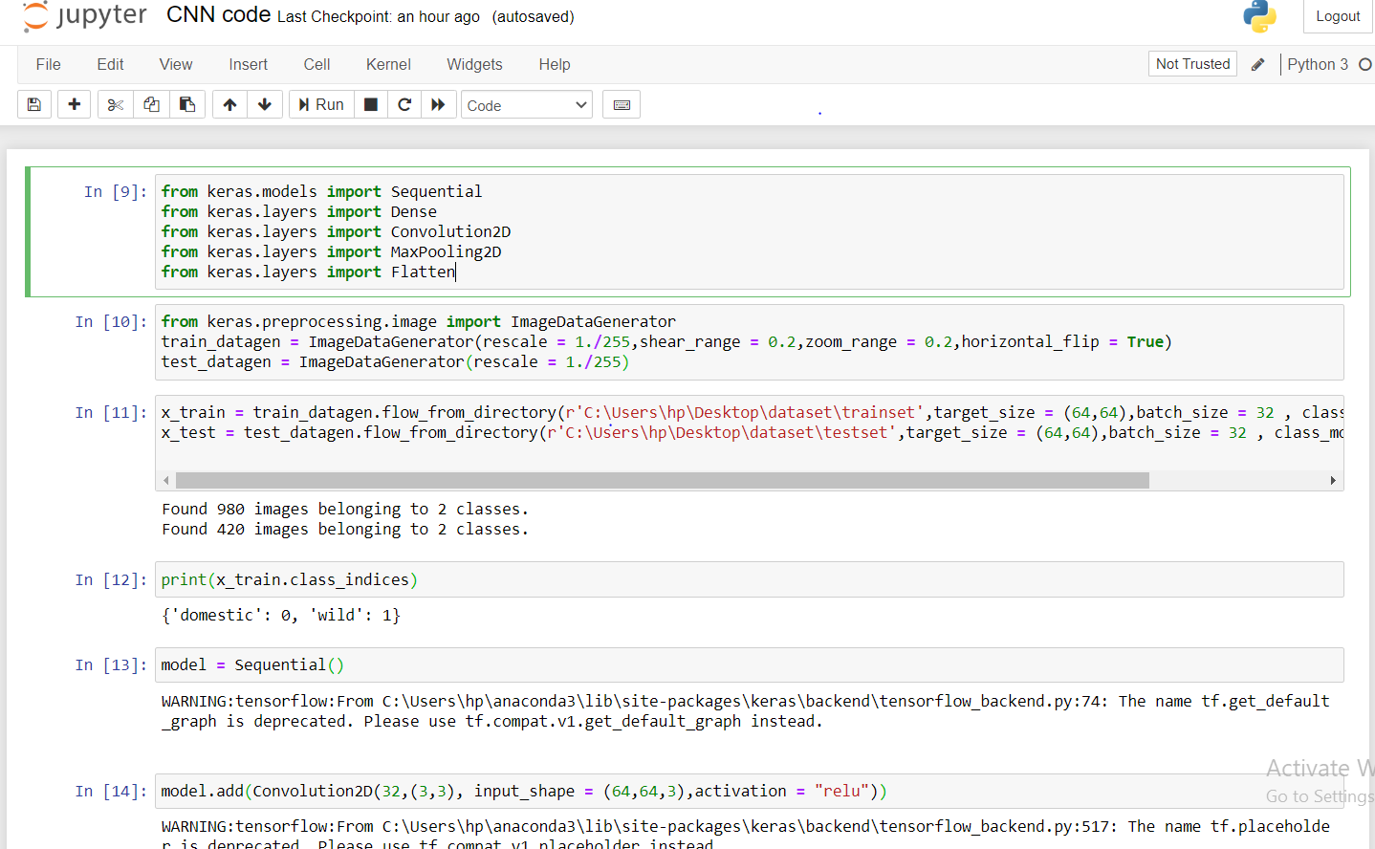
IMPLEMENTATION:

Slide 13
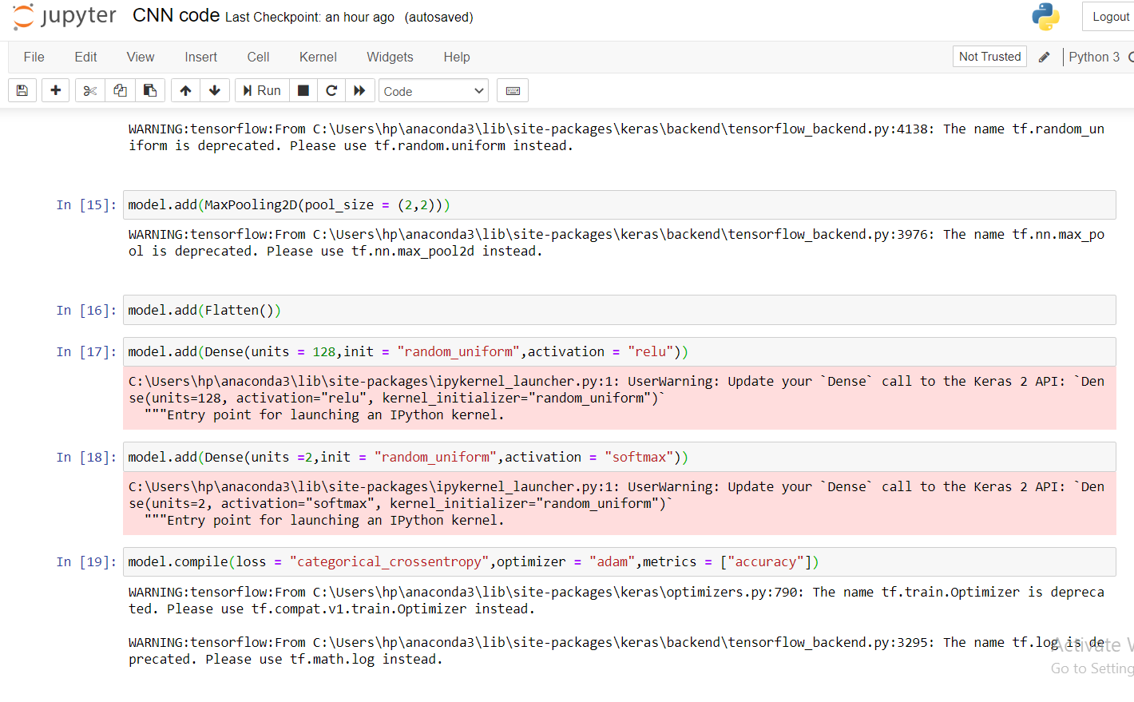

Slide 14
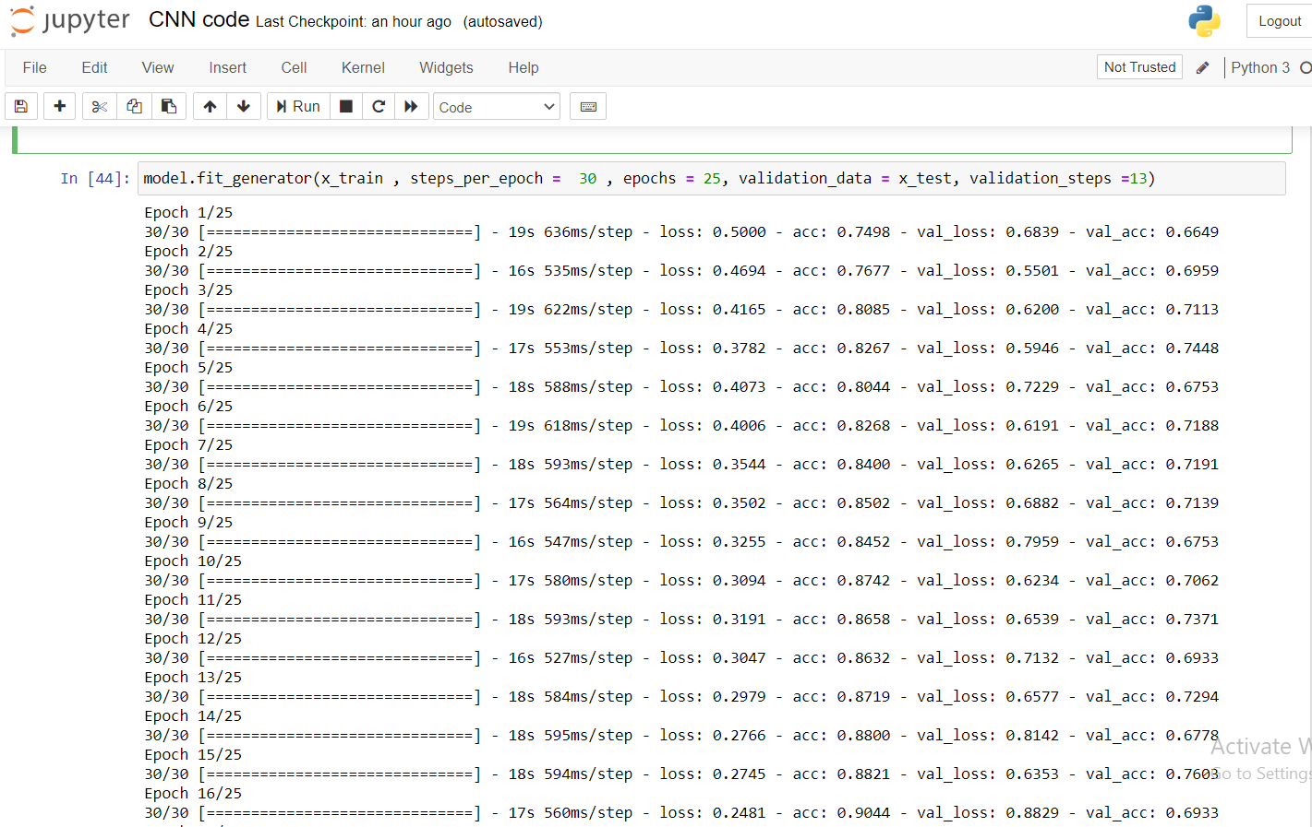

Slide 15
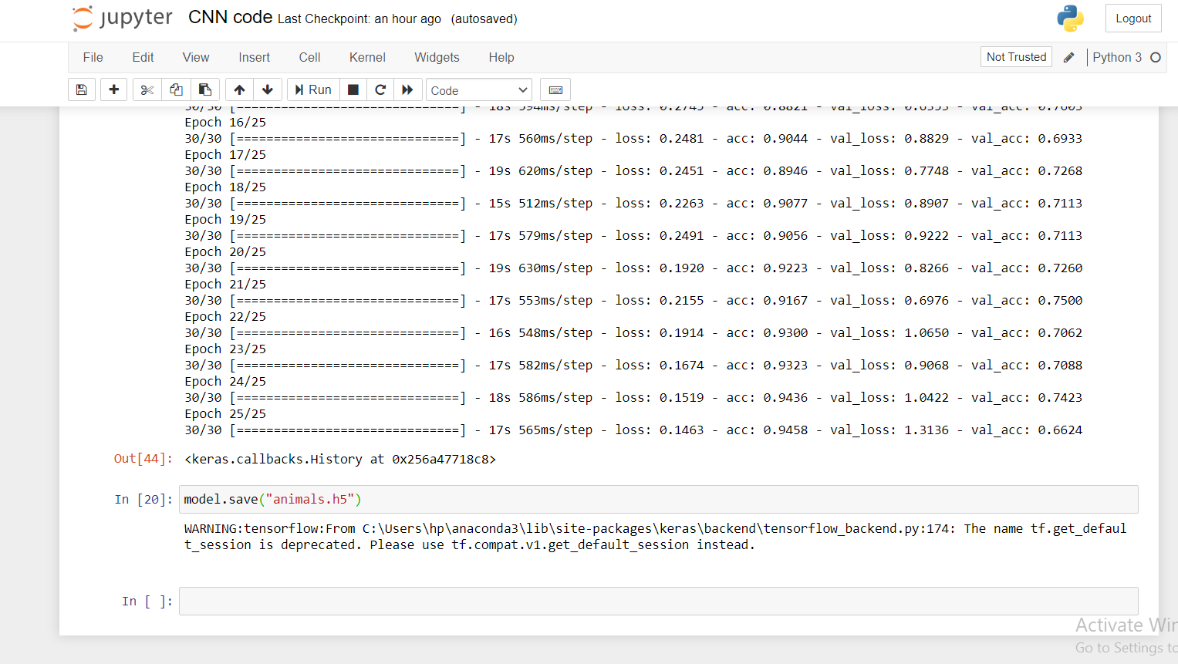

Slide 16
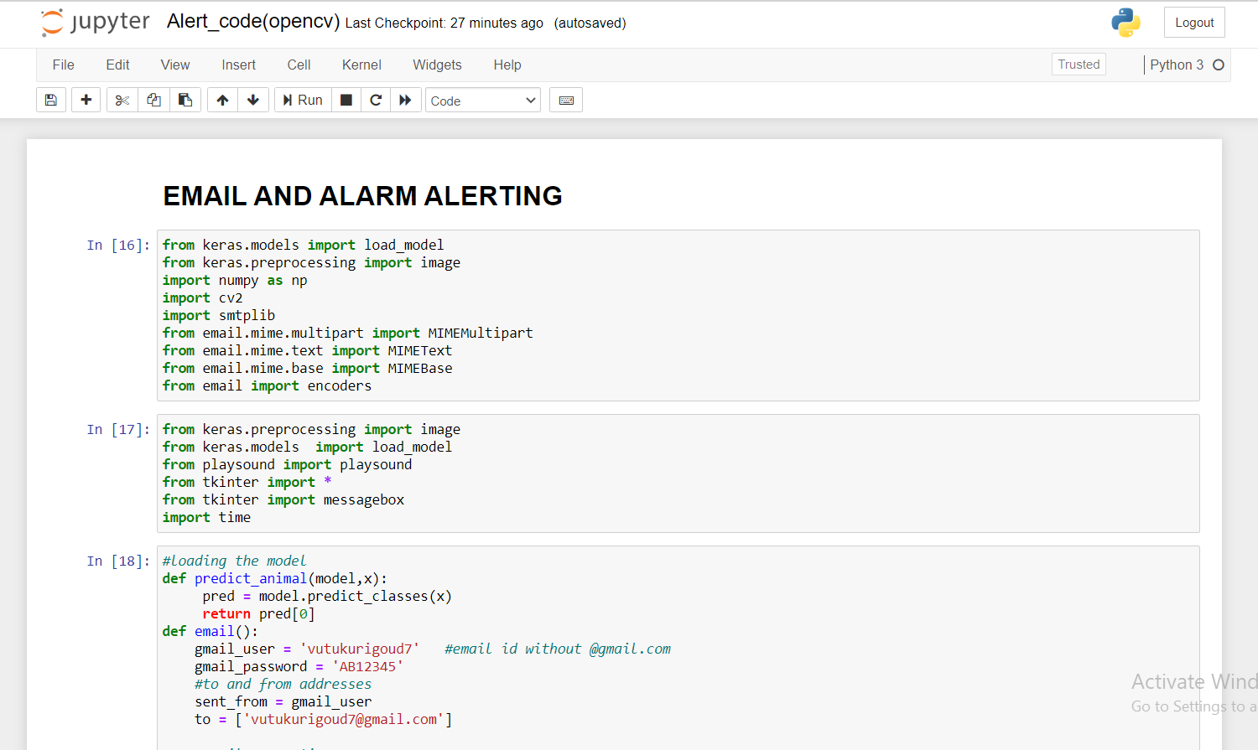

Slide 17
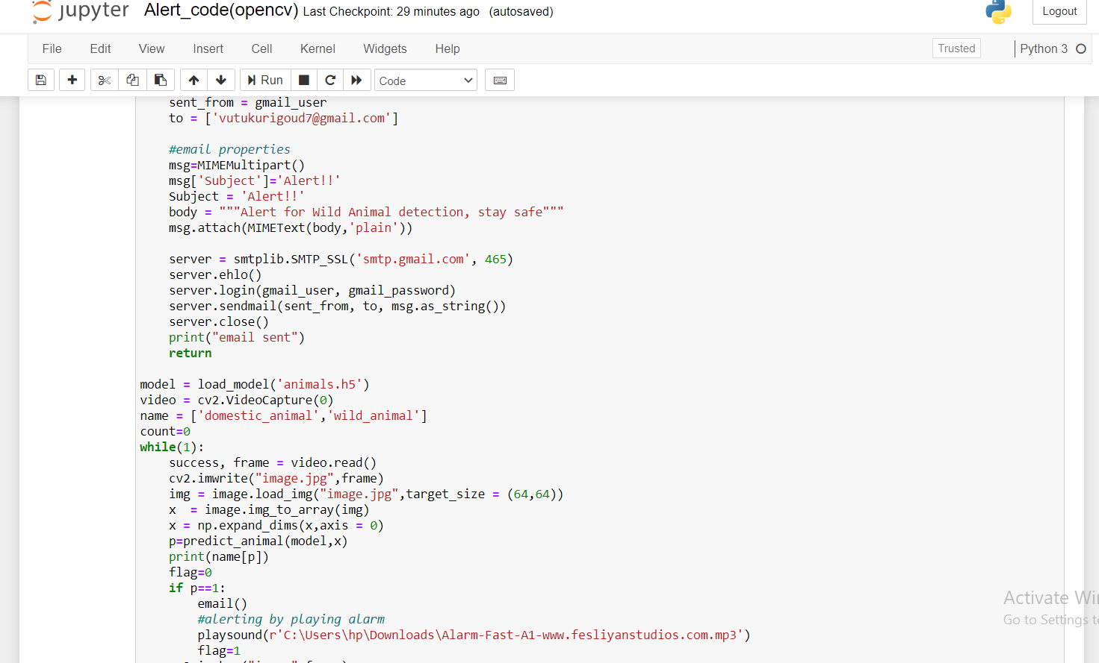

Slide 18
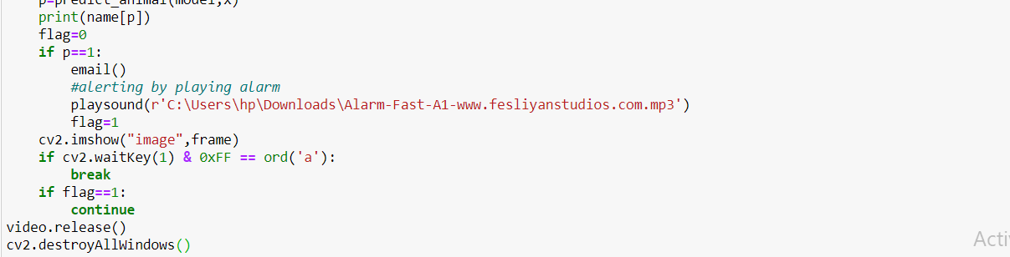

Slide 19
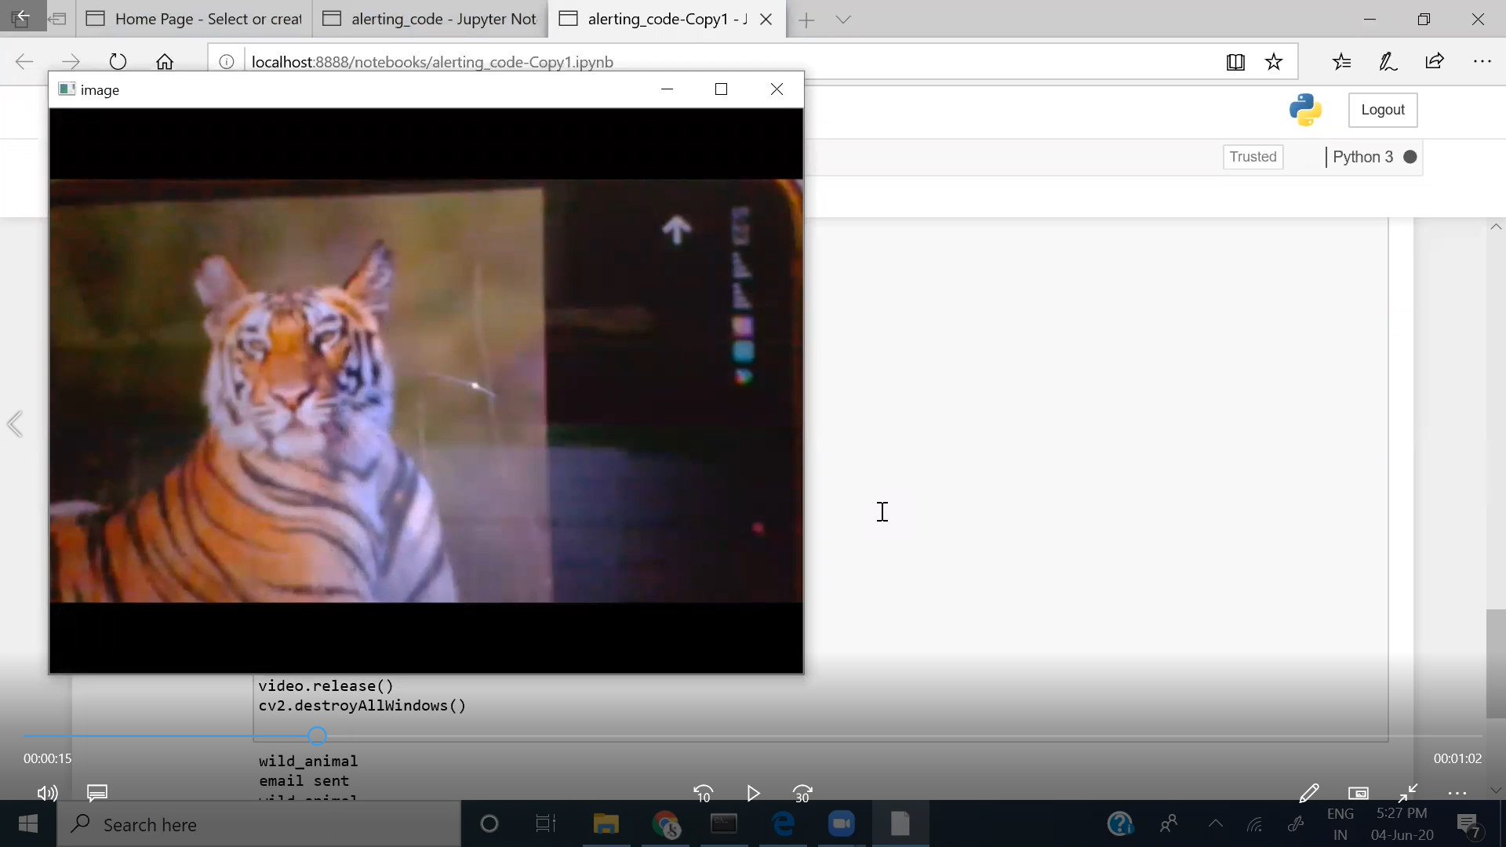
OUTPUT:

Slide 20
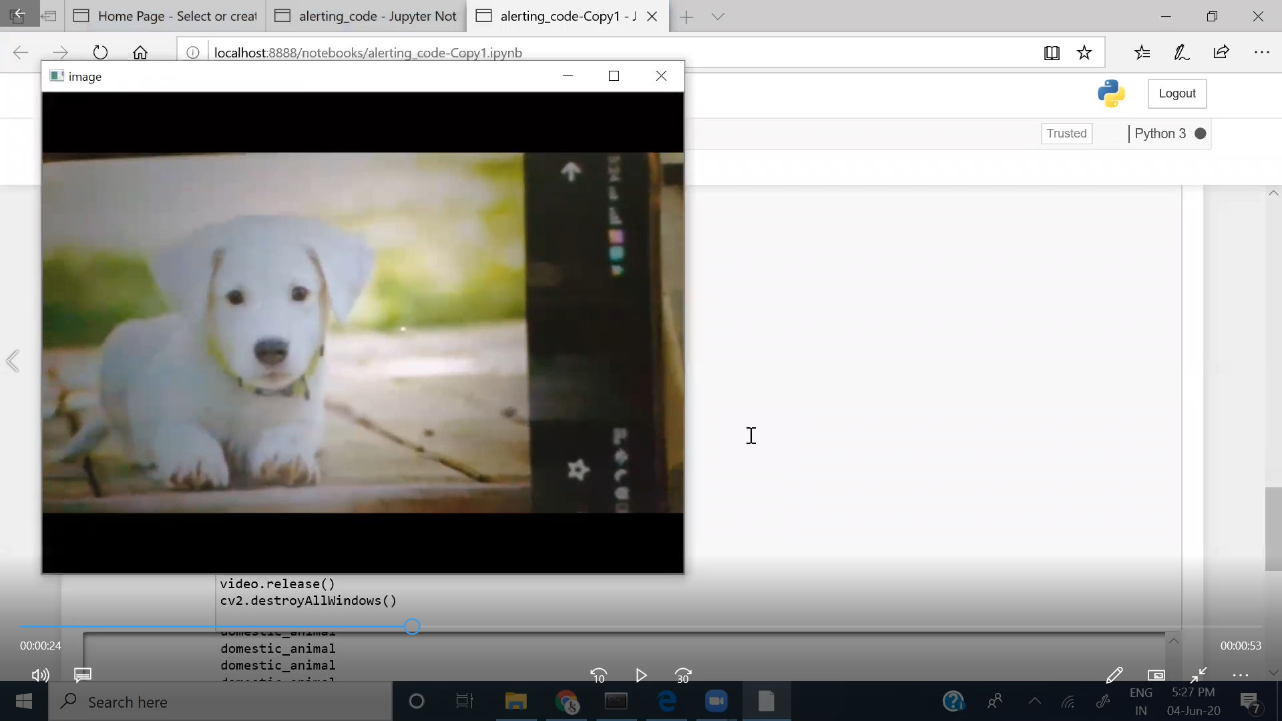

Slide 21
BIBLIOGRAPHY:
Data collection : https://www.kaggle.com/datasets
Data Preprocessing : https://thesmartbridge.com/documents/spsaimldocs/CNNprep.pdf
Model Building : https://thesmartbridge.com/documents/spsaimldocs/CNNflow.pdf
OpenCV for video processing :
https://opencv-python-t utrials.readthedocs.io/en/latest/py_tutorials/py_gui/py_ video_display/py_video_display.html
Alerting through Email : https://www.youtube.com/watch?v=B1IsCbXp0uE

Slide 22

CERTIFICATE:
Caption

Slide 23
COMPANY NAME : SMART BRIDGE EDUCATIONAL SERVICES PVT.LTD
ADDRESS : PLOT NO:132, ABOVE DCB BANK, SECOND FLOOR, BAPUJI NAGAR, HABSIGUDA, NACHARAM MAIN ROAD, HYDERABAD - 500076

Slide 24
THANK YOU!

